Slide 1

Human Resource Dataset presentation
Team Three (3)
Youssef
Nadeem
Rana
Eslam

Slide 2
Objective:
Data cleaning
Data analysis
Data visualization
Provide data-driven decision

Slide 3
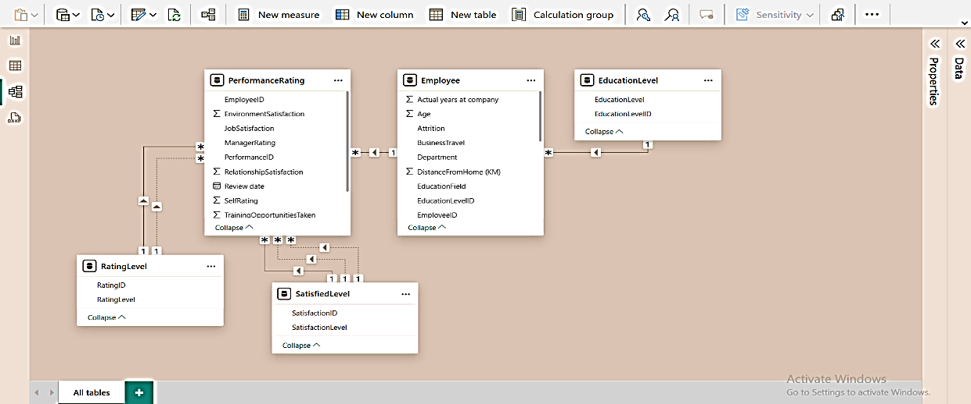
Data overview
Company information about employees describes each employee, his education level, name, gender, salary, performance, years at company, satisfaction, attrition……
five tables (Education Level, Employee, Performance Rating, Rating Level, Satisfied Level)

Slide 4
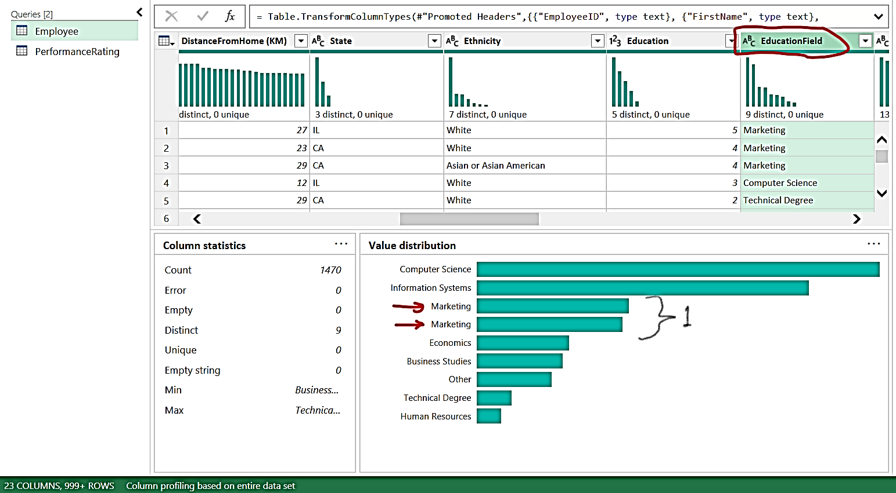
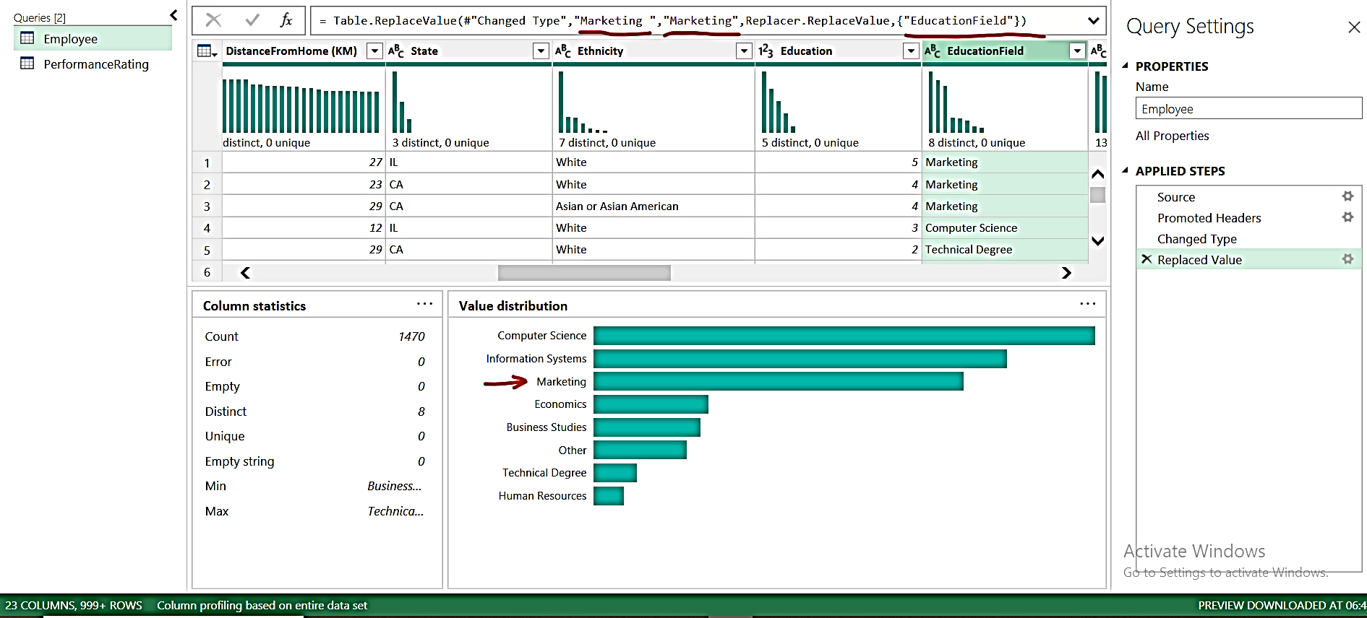
Cleaning steps
Replacing values:

Slide 5
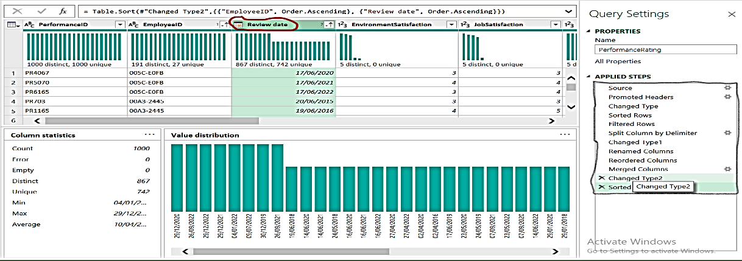
Cleaning steps
Editing dates formatting:
Transforming date from mm/dd/yyyy to dd/mm/yyyy
Split columns
Reorder columns
Merge columns
Change data type to “date” data type

Slide 6
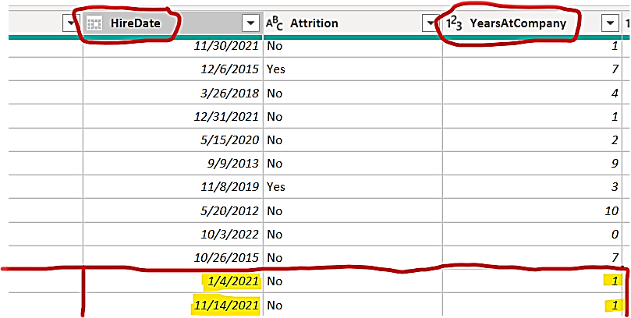
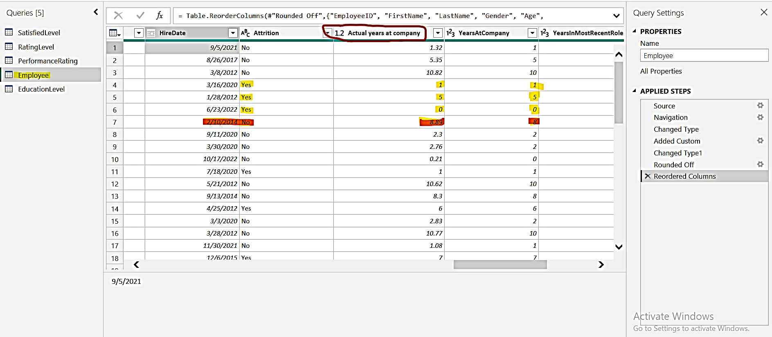
Calculations and grouping
Creating the "Actual years at company" Column:
As years at company column wasn’t accurate, we created a new column that shows the actual years at company with 2 decimal numbers.

Slide 7
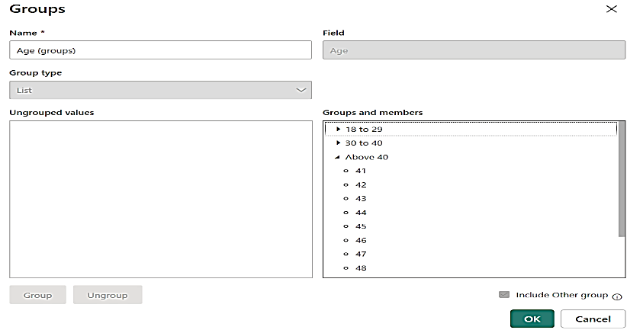
Calculations and grouping
Grouping (ages, salaries, distances from home)
Measure of attrition percentage
We used Dax Function to measure the attrition percentage as shown below.
Count of Attrition divided by Count of Attrition = 100*
DIVIDE(
CALCULATE(COUNTA('Employee'[Attrition]), 'Employee'[Attrition] = "Yes"),
CALCULATE(COUNTA('Employee'[Attrition])))

Slide 8

Analysis questions
Do employees rating and years at company affect their salaries and promotions ?
What is the effect of marital status on employee performance, travelling and overtime?
What are the differences in job satisfaction and attrition across different departments?
What are the differences between departments across average salaries, employees rating and education?
Employees performance
Departments comparison
Attrition factors and reasons
What are the key factors influencing employee attrition rate?
Is there a correlation between tenure (years at company) and attrition?
Do employees with higher salaries have lower attrition rates?

Slide 9
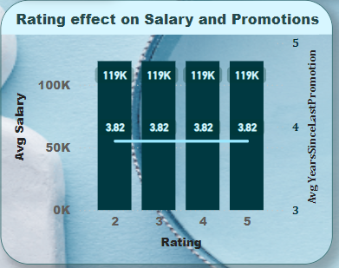
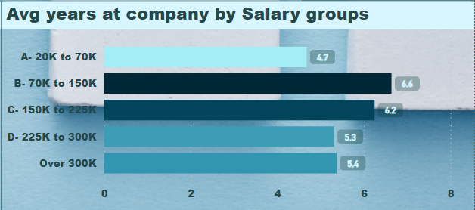
Conclusion
1. Employee performance ratings should influence salary increases and promotions. Rewarding high performers will motivate employees to work harder.
2. Giving salary increases based on how long employees stay at the company can encourage them to remain for longer periods.

Slide 10
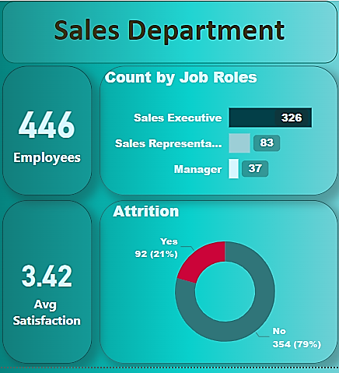
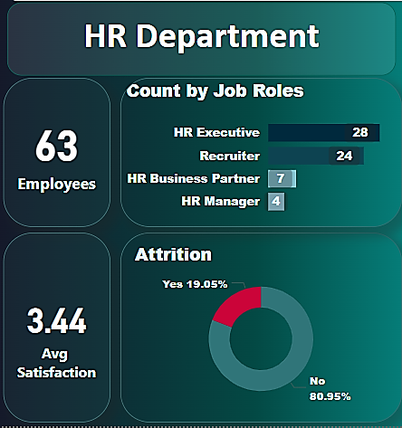
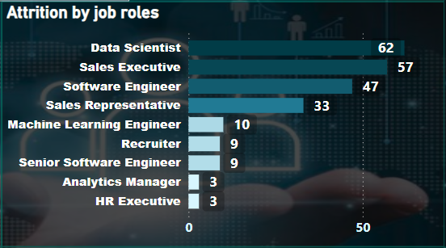
Conclusion
3. The sales and HR departments need attention due to high turnover. Finding out why employees are leaving and making improvements will help reduce attrition in these departments. Also, compensating the candidates who have left is important.
4. Jobs like data scientist, sales executive, and software engineer need special attention. The company should figure out why employees in these roles are leaving and offer better compensation or growth opportunities.

Slide 11
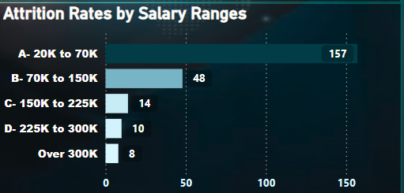
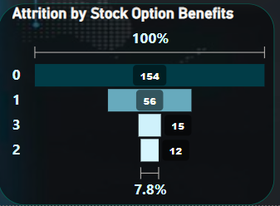
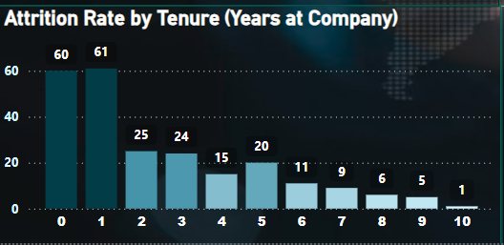
Conclusion
5. Raising base salaries and offering more stock options can help reduce employee turnover, especially for lower-paid employees. This may also improve employee performance.
6. The longer the employees stay with the company the lower the attrition rate, which is an indication of good company work environment.

Slide 12
Any Questions?
Thank You

